Slide 1
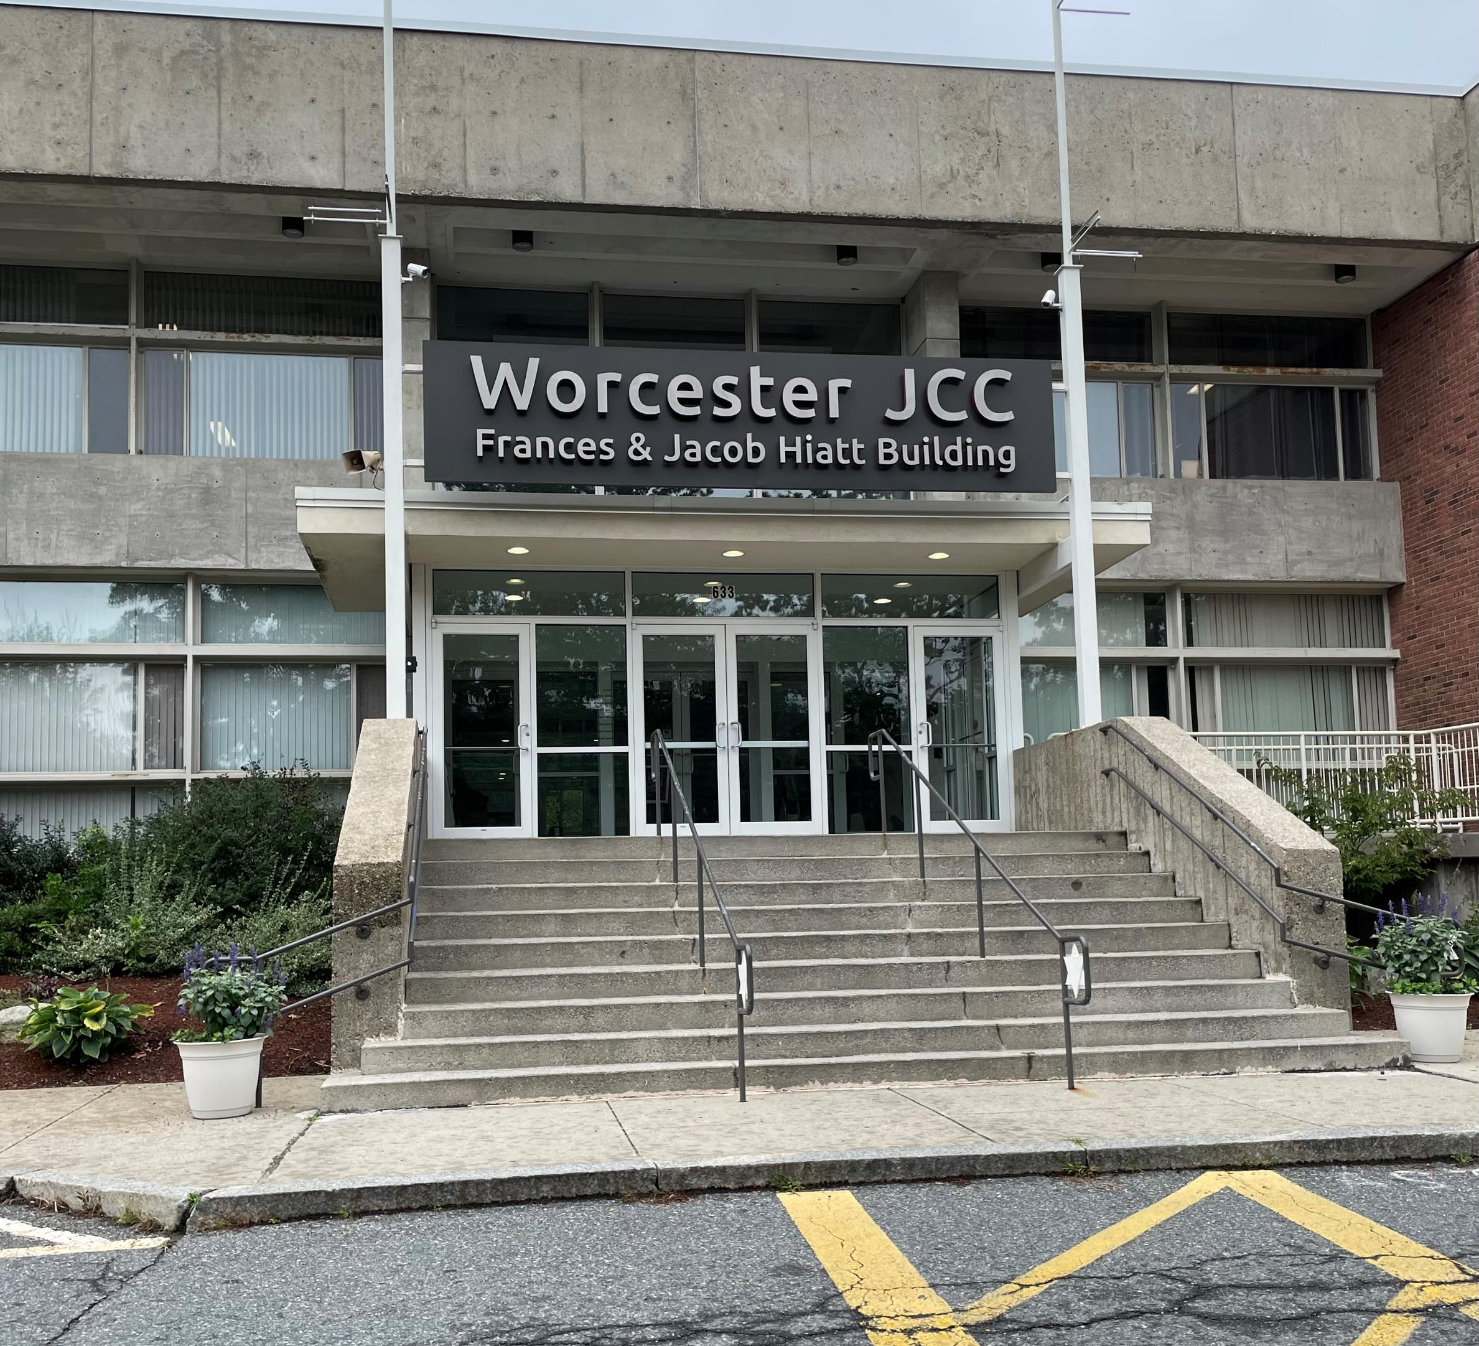

Swimming Lessons at the JCC
With the Autism Resource Center and Worcester District Attorney’s Office

Slide 2
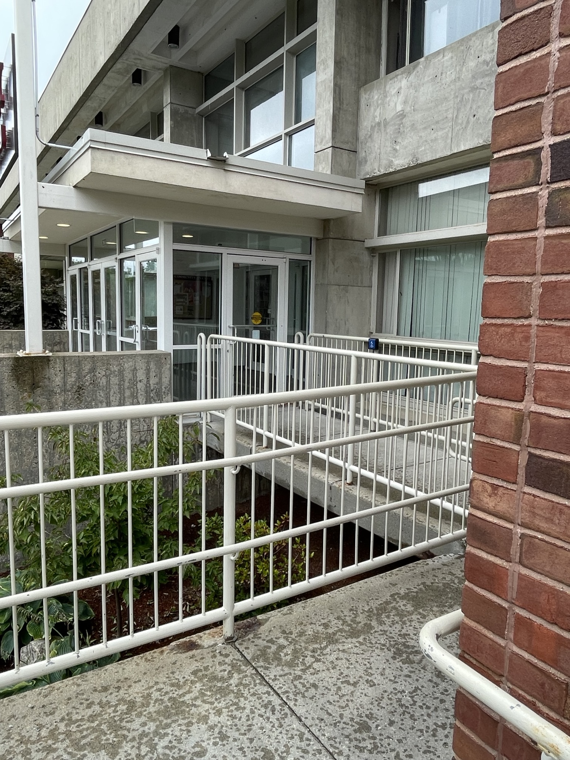
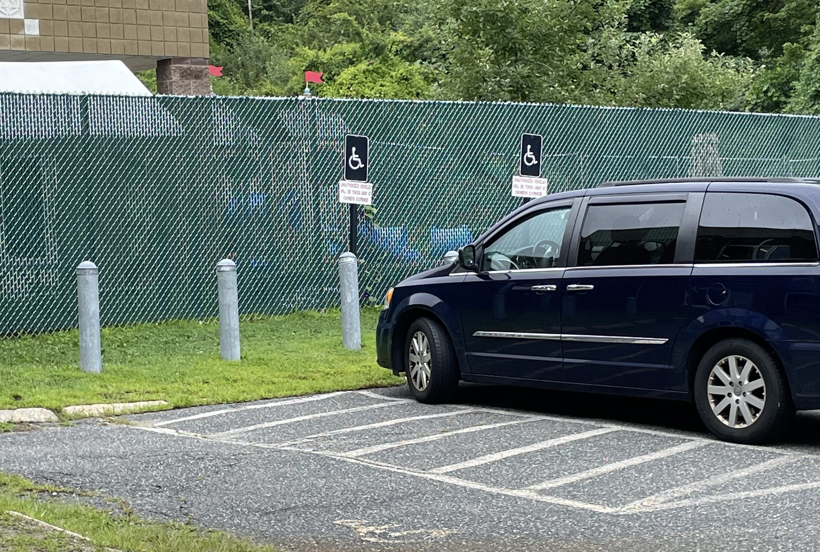
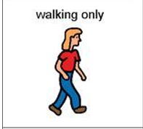
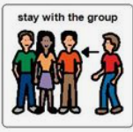
I am going to swim lessons at the JCC. When we get there, we will park the car and I walk safely up the ramp to the building.

Slide 3
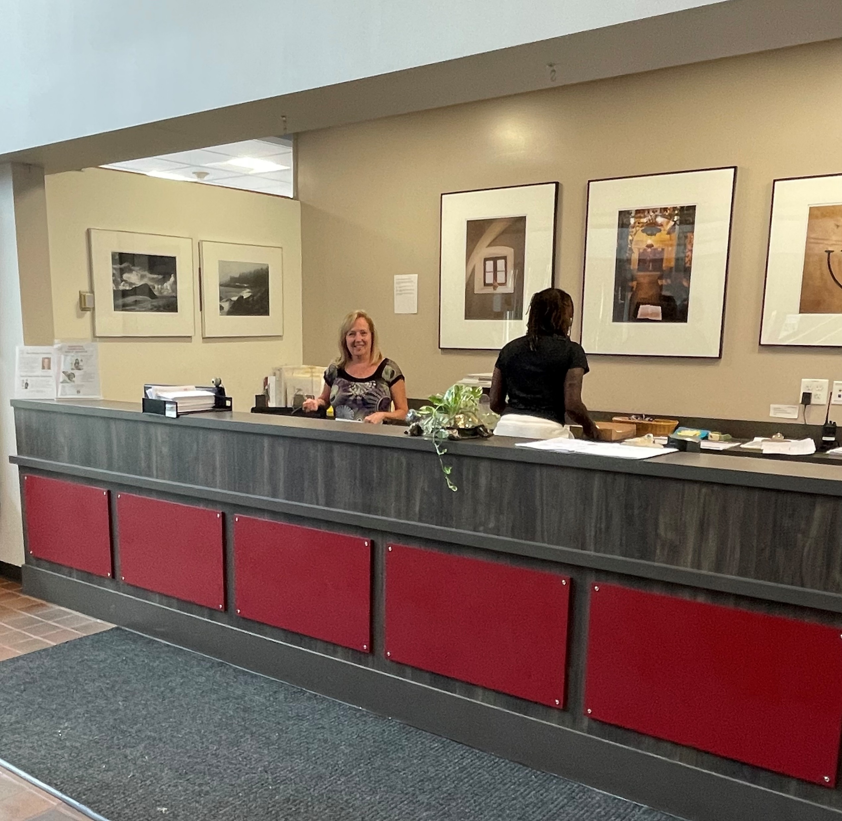
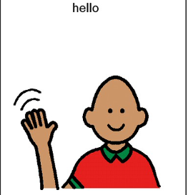
Swimming lessons are fun! I am excited to learn how to swim better.
When I get to the JCC, I will see my teacher and my classmates. The teacher is there to help me learn. The other kids are there to learn too.

Slide 4
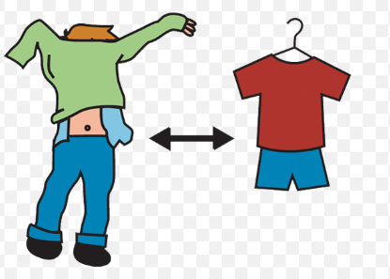
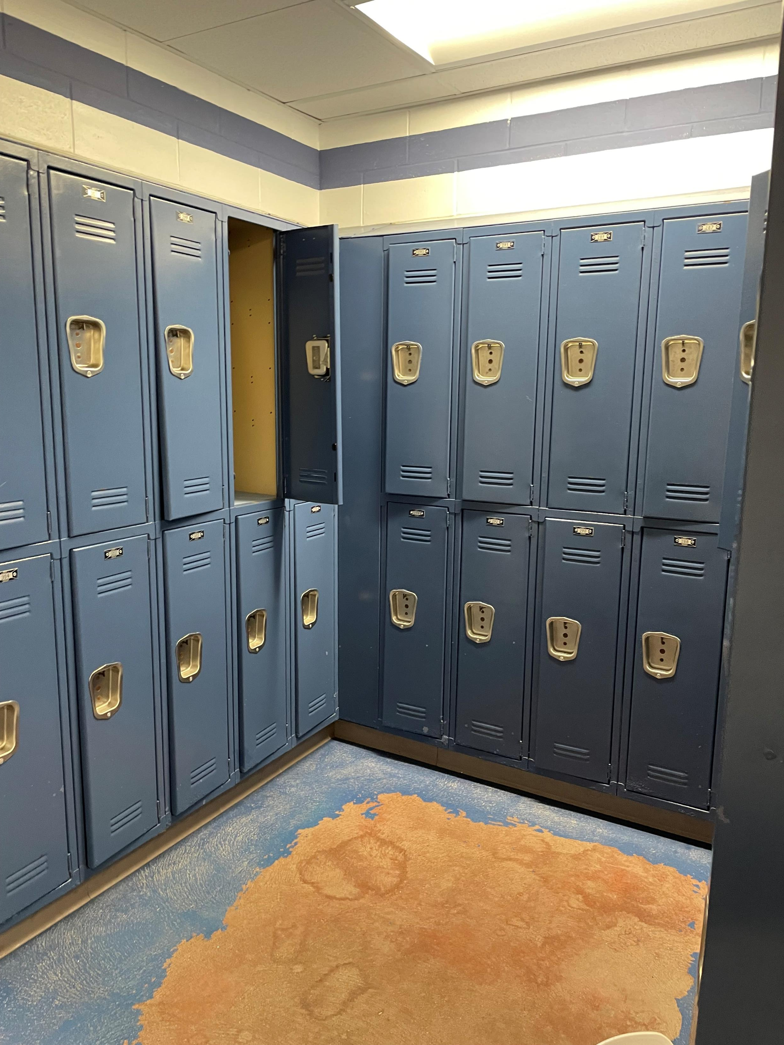
Before we start swimming, I will change into my swimsuit in the locker room. I can ask for help if I need it. It’s great that I have my towel ready.

Slide 5
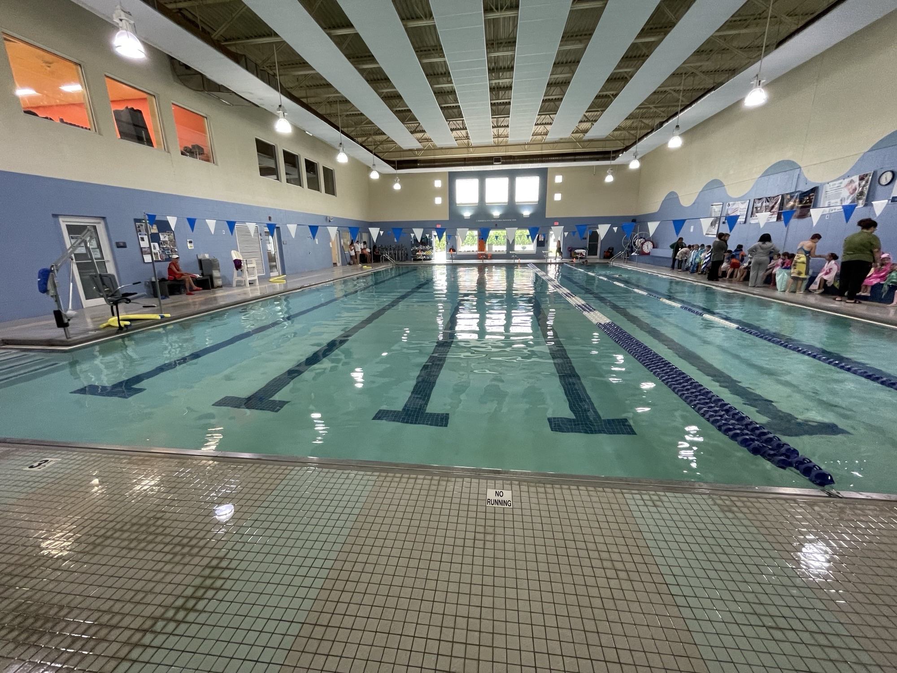




In swimming lessons, I will learn new skills. I will practice floating, kicking, and breathing in the water. I might feel a little nervous, but that is okay! I can take deep breaths to help me feel calm.

Slide 6
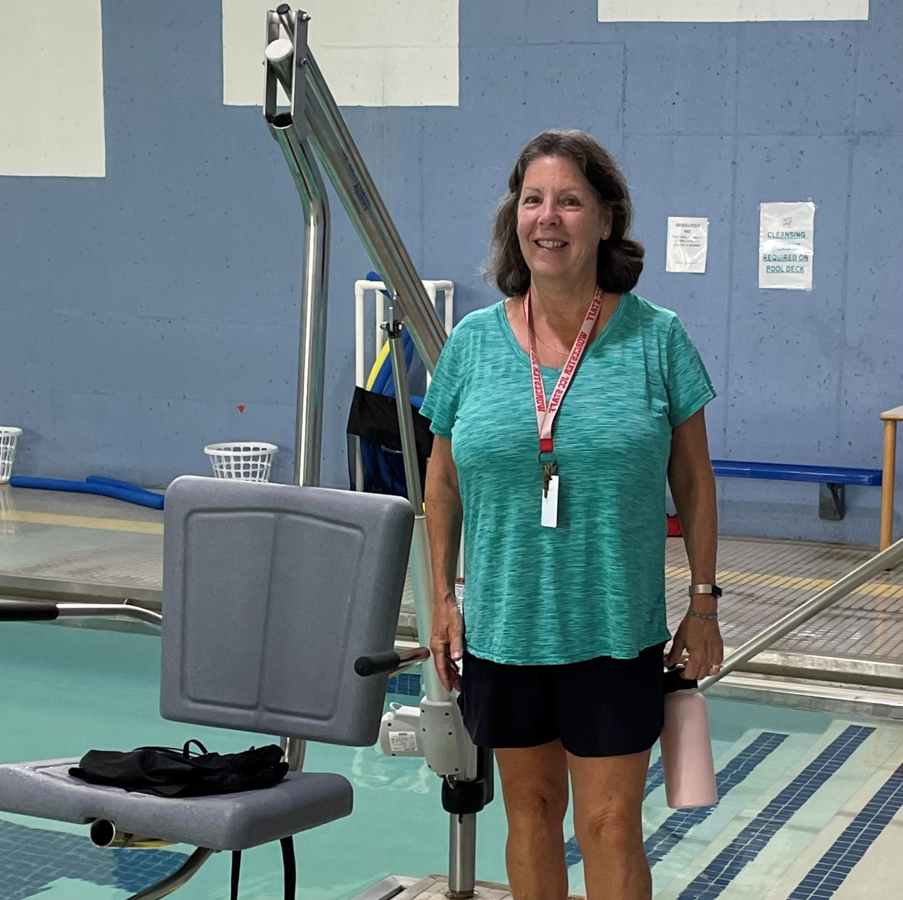
Kelly will be my swim instructor! She will help me learn to swim!

Slide 7
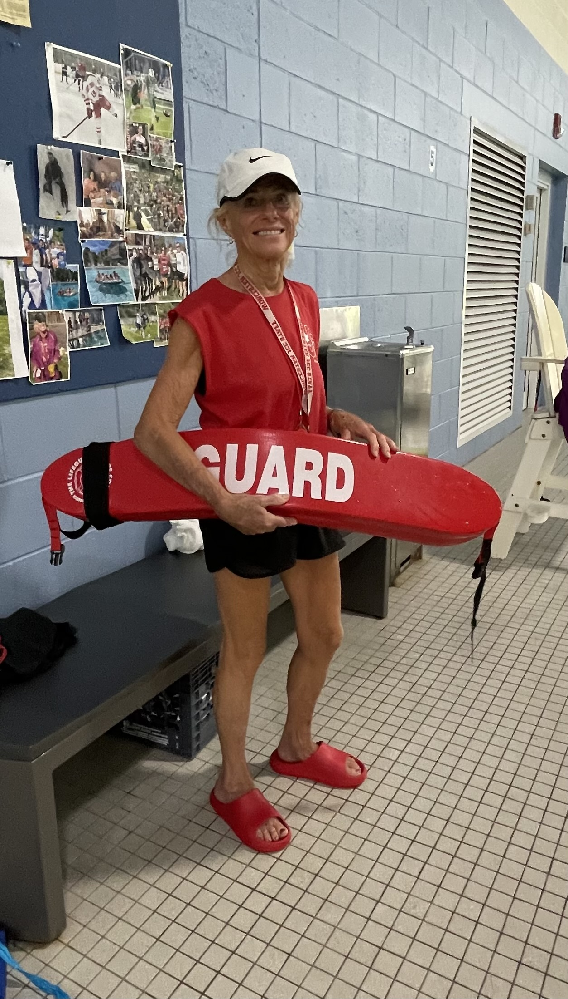

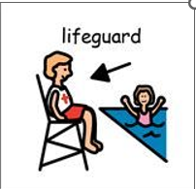
If I have questions, I can raise my hand. If I feel unsure, my teacher will help me. It's nice that my friends can cheer me on when I do a good job.

Slide 8
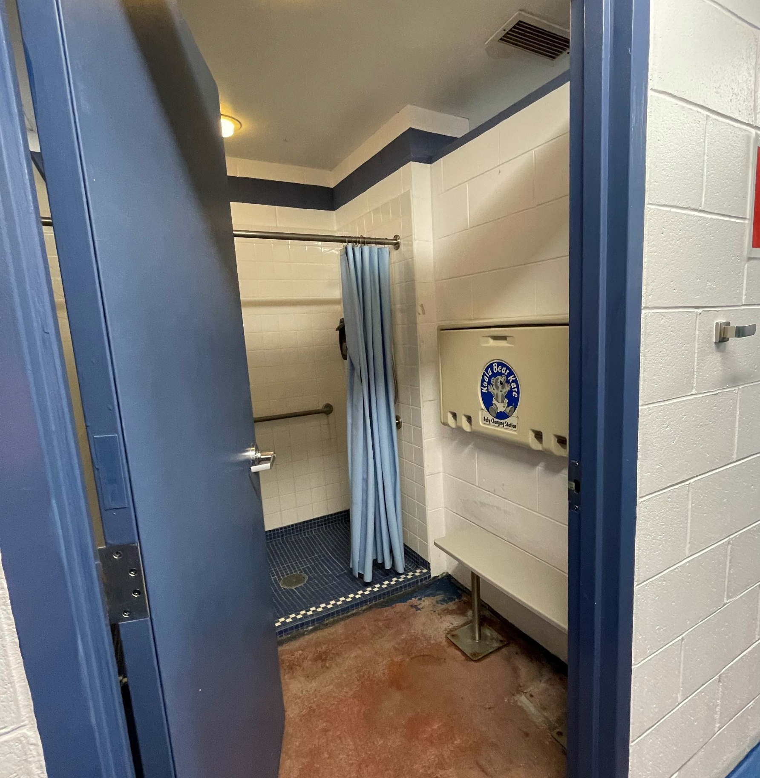

After swimming, I will dry off and change back into my clothes. I may be asked to take a shower. I will feel proud of myself for trying my best!

Slide 9

I am excited to go to swimming lessons at the JCC. I will have fun and learn new things!

